Slide 1
Tuesday, January 29, 2013
Agenda:
TISK, No MM
Lesson 12-4: Functions
Homework: Ch 12 HW Packet #2, §12-4 problems
TISK Problems
Write an equation in slope-intercept form for a line that passes through the points (0, 4) and (-2, 6).
Find the probability of rolling a multiple of 3 on a fair 12-sided die numbered 1-12.
Write and solve a proportion:
Four is what percent of 24?

Slide 2
§12-4 Functions
Domain
  All the values possible for the input.
Range
  All the values possible for the output.
Function
  A rule that takes every input in the domain and maps it to exactly one output in the range.

Slide 3
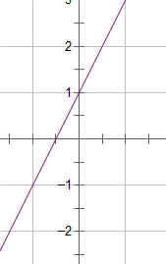
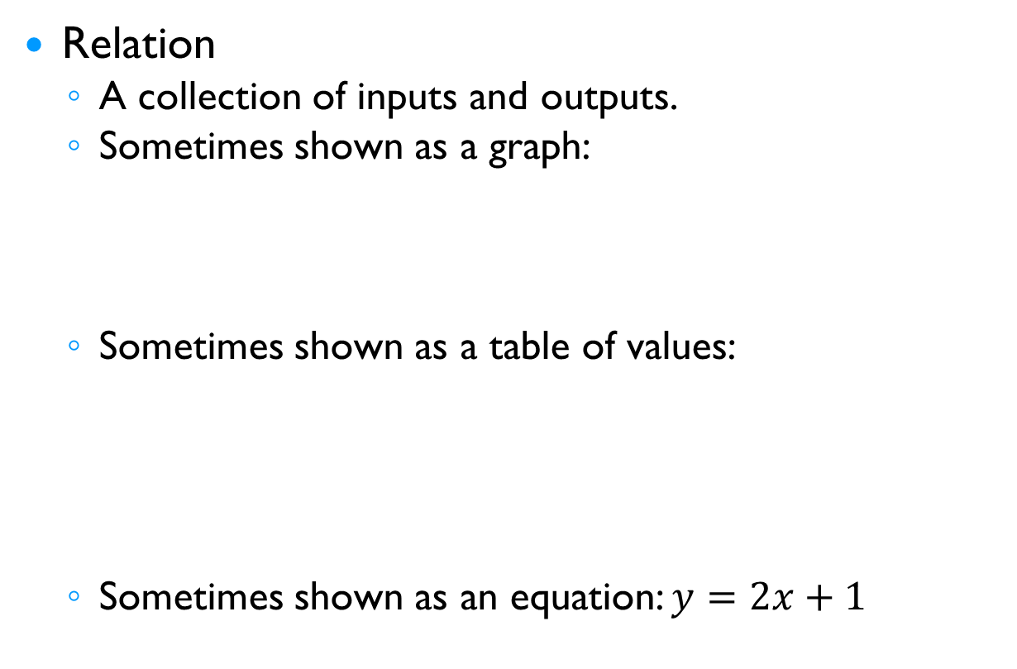
§12-4 Functions
Relation
  A collection of inputs and outputs.
  Sometimes shown as a graph:
  Sometimes shown as a table of values:
  Sometimes shown as an equation: $y=2x+1$
x | y
-2 | -3
-1 | -1
0 | 1
1 | 3

Slide 4


§12-4 Functions
How can you tell if a relation is a function?
  Check to see if every input has only one output.
x | y
-2 | -3
-1 | -1
0 | 1
1 | 3
x | y
1 | 7
-2 | 8
-3 | 7
4 | 8
x | y
-1 | 6
2 | 20
-1 | 4
3 | 20
The input of -1 has two outputs, 6 and 4.

Slide 5
§12-4 Functions
How can you tell if a relation is a function?
  Use the vertical line test (VLT).
Yes, it’s a function. It passes the VLT.
No, it’s not a function. It fails the VLT.

Slide 6
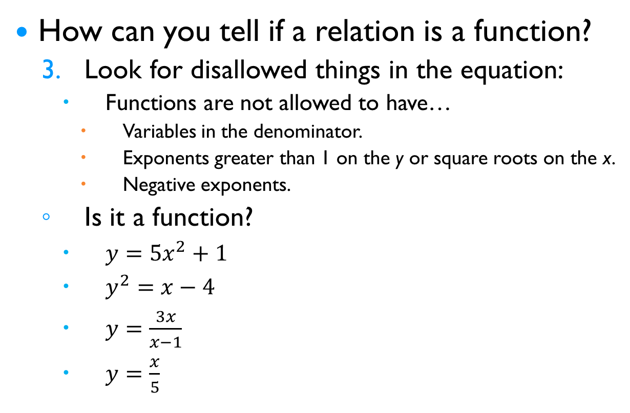
§12-4 Functions
How can you tell if a relation is a function?
  Look for disallowed things in the equation:
    Functions are not allowed to have…
      Variables in the denominator.
      Exponents greater than 1 on the y or square roots on the x.
      Negative exponents.
  Is it a function?
    $y=5x^{2}+1$
    $y^{2}=x−4$
    $y=\frac{3x}{x−1}$
    $y=\frac{x}{5}$
It has no “illegal” items.
It has an exponent of 2 on the y.
It has an x in the denominator.
It has no “illegal” items.

Slide 7
§12-4 Functions
We use set notation to indicate the values in the Domain and Range of a function.
In set notation…
  {a, b, c, … } means a set of numbers
    {2, 4, 8, 11, 12}
  (a, b) means all the numbers starting at a and ending at b, but NOT INCLUDING a or b.
    (5, 12)
  [a, b] means all the numbers starting at a and ending at b and INCLUDES both a and b.
  What do you think (a, b] means?
  What about [a, b) ?
  What about [a, b) U {c, d}?

Slide 8
§12-4 Functions
Give the domain and range of the following relations:
x | y
-2 | -3
-1 | -1
0 | 1
1 | 3
Domain (D):
{
-2,
-1,
0,
1
}
Range (R):
{
-3,
-1,
1,
3
}
Domain (D):
[
-2,
-1]
U[0,
1
]
Range (R):
[
0,
1]
U
{2
}

Slide 9
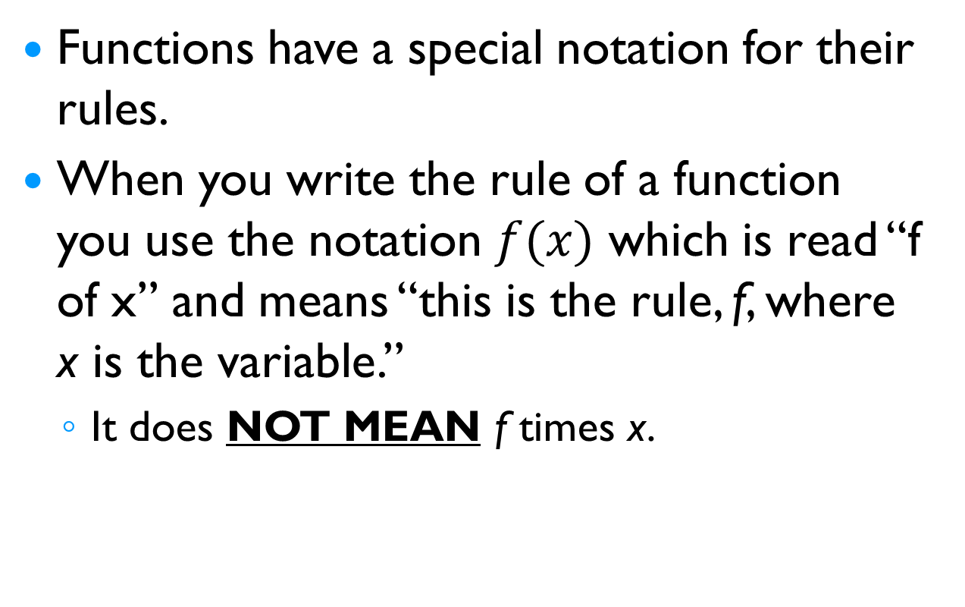
§12-4 Functions
Functions have a special notation for their rules.
When you write the rule of a function you use the notation $f(x)$ which is read “f of x” and means “this is the rule, f, where x is the variable.”
  It does NOT MEAN f times x.

Slide 10



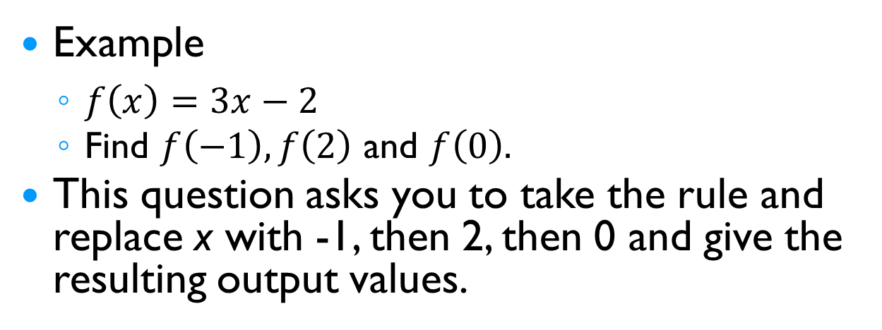

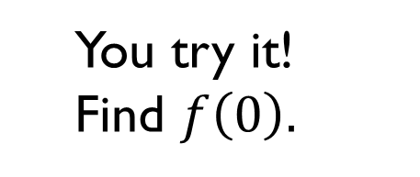




§12-4 Functions
Example
  $f\left(x\right)=3x−2$
  Find $f\left(−1\right), f\left(2\right)$ and $f\left(0\right).$
This question asks you to take the rule and replace x with -1, then 2, then 0 and give the resulting output values.
  You try it! Find $f\left(0\right).$
  $f\left(x\right)=3x−2$
  $f\left(x\right)=3x−2$
  $f\left(−1\right)=3(−1)−2$
  $f\left(2\right)=3(2)−2$
  $f\left(−1\right)=−3−2$
  $f\left(2\right)=6−2$
  $f\left(−1\right)=−5$
  $f\left(2\right)=4$
  So for this rule, when you input -1 you get an output of -5.
  So for this rule, when you input 2 you get an output of 4.

